Slide 1
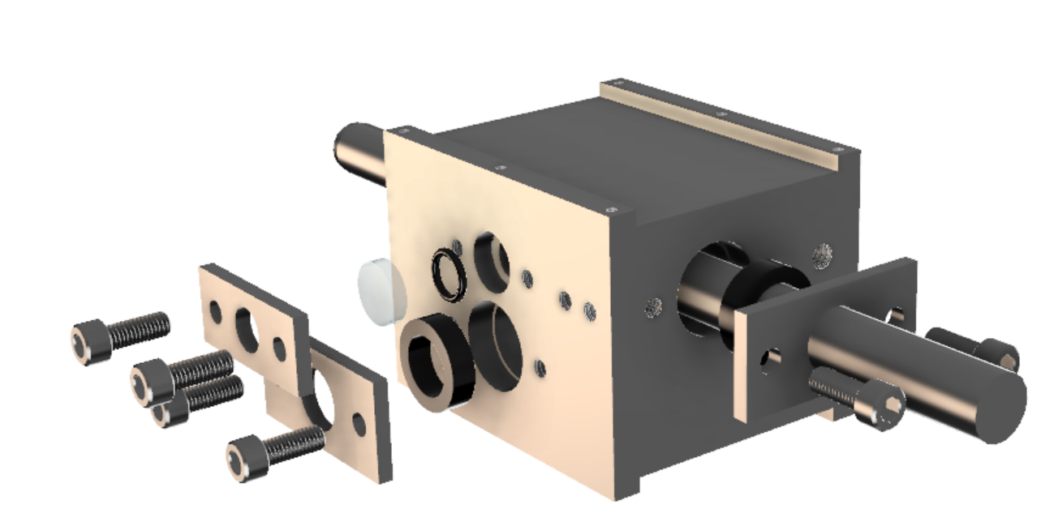
HPAFM Chamber Assembly
Chamber
O-ring
Window
Cup Seal
Window
Follower
Seal Follower
Cup Seal
10-32 bolts
Seal Follower
Positioning Rod

Slide 2
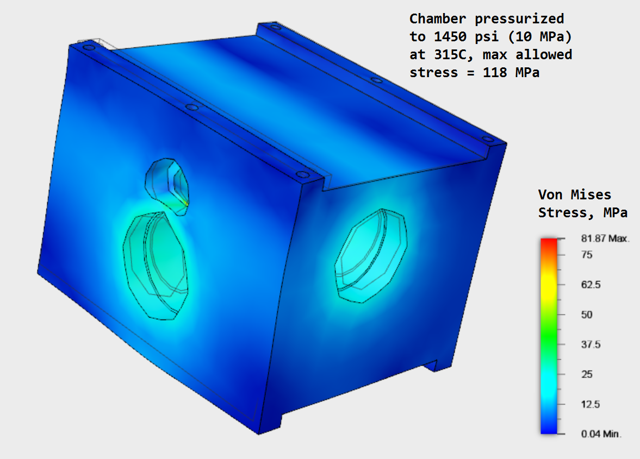
HPAFM Chamber Stress

